Slide 1


By : Roy Shlomo Chen & Yarin Akiva
Data Science Project
Portugal Real Estate

Slide 2


What is real estate?
Real
Estate
Real estate is an ever-changing industry that involves the buying, selling, and renting of land and buildings. It is a great way to generate income and build wealth, and real estate professionals can help clients find the perfect property.
Portugal Real estate
Portugal is a desirable destination for real estate investment due to its attractive cost of living, favorable tax climate, and booming property market. The country has seen a surge in foreign investment, with property prices in the major cities rising steadily in recent years.

Slide 3

Research Question
How to identify a good investment property in Portugal ?

Slide 4
Why Did We Choose This Subject?
Increase in Jewish applications for a Portuguese passport
In recent years, Jews who could prove that they were deported from Spain, could submit an application to the Portuguese authorities and the Jewish community living in Porto or Lisbon, and ask for citizenship in Portugal only by proving that they are descendants of those deported from Spain.
The hardening of the Portuguese government's conditions
At the end of 2022, the Portuguese government decided to tighten the conditions for obtaining citizenship and a Portuguese passport for the descendants of those deported from Spain, and from now on you also have to show affinity to the state of Portugal.

Slide 5
Why did we choose this topic?
The solution
One of these ways is to invest or purchase real estate in Portugal.
We decided to check whether it is possible to analyze the information on properties in Portugal using the Remax Portugal website, and to determine what is a good property for investment in Portugal.
The goal
The goal is to help those Jews who want to become citizens in Portugal, and they are now faced with the tightening of the conditions for obtaining citizenship/

Slide 6
Main Process Steps
1
Obtaining Data
2
Data Handling
3
Exploring Data
4
Machine Learning
5
Interpreting Data

Slide 7
what happens at each stage
1
2
3
5
4
web scraping for collection , and obtaining the data
Cleaning,
formatting
and filtering the data, removing duplicates data
Visualizing and
understanding the data
Presentation of data,
understanding and delivering the results
Clustering the data
in groups and modeling , and apply ML modeling on the data

Slide 8


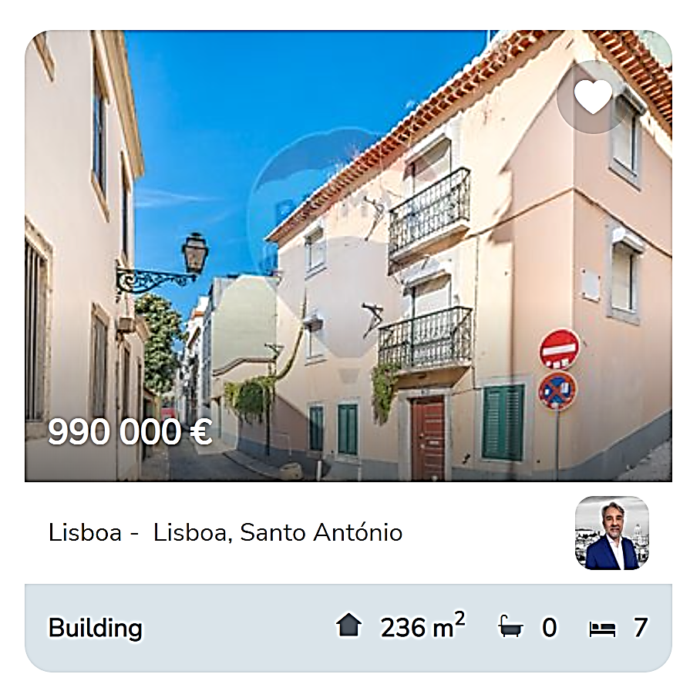
Step 1 Obtaining Data
Source
In this step, we will collect information of properties in Portugal in various big cities
we will crawl along web pages and scrape information about properties features
Main tools :
BeautifulSoup, Selenium
Source Data : https://www.remax.pt/en/

Slide 9
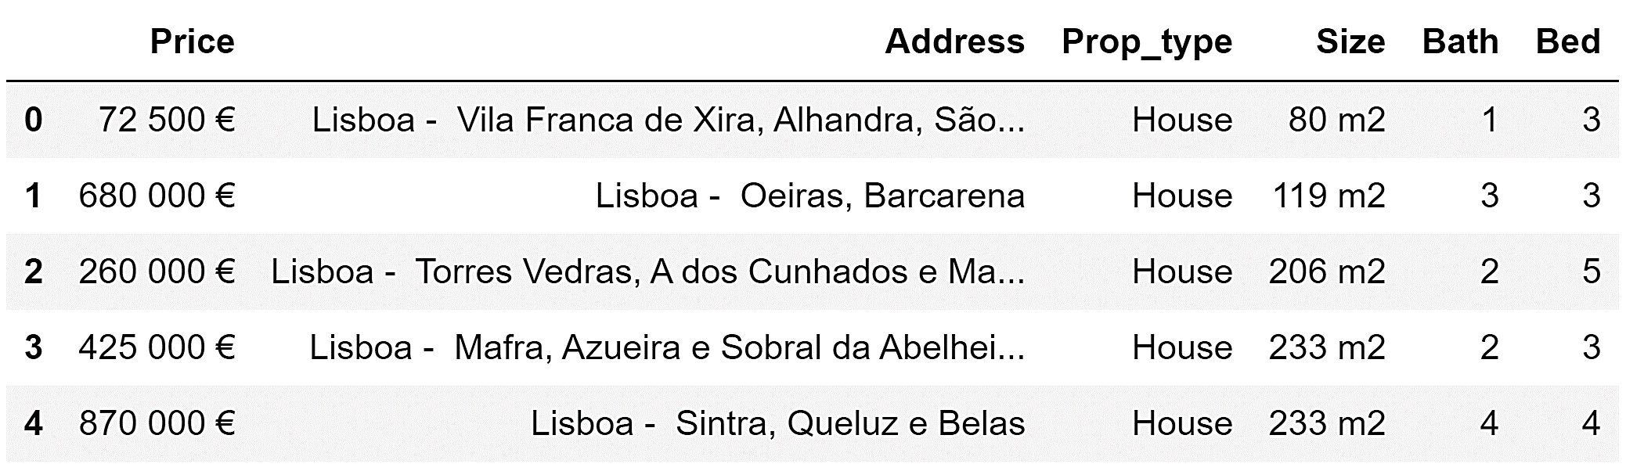
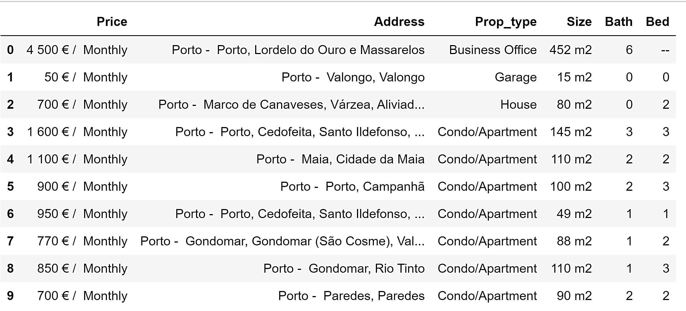
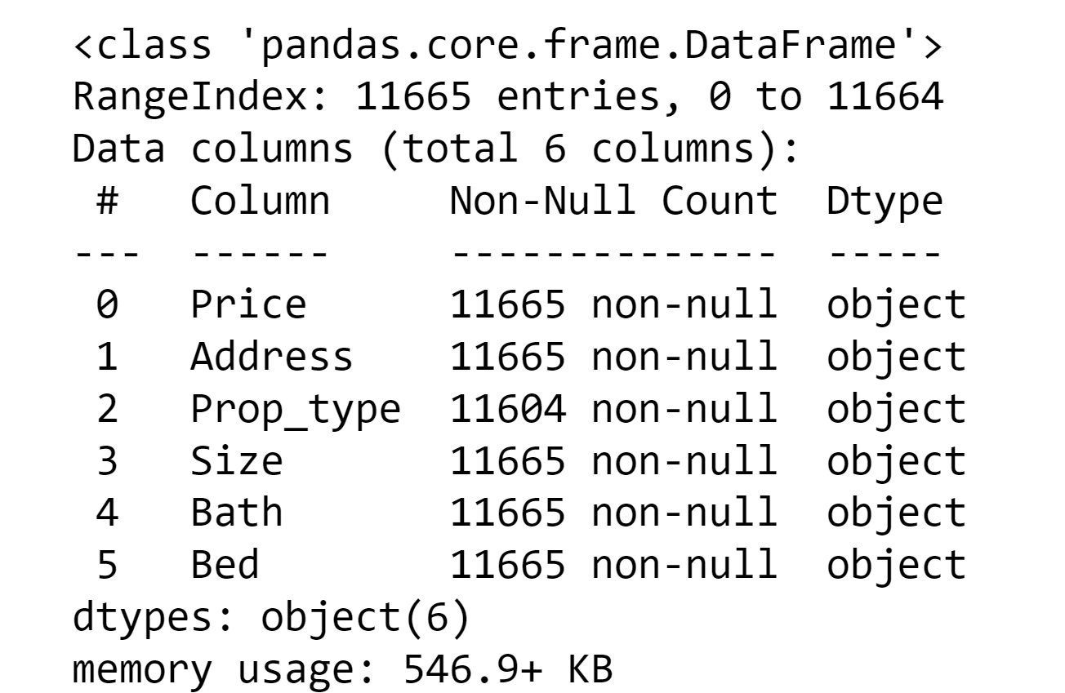
The process
To collect each property, we used Selenium because this is
a dynamic scrapping,
After we passed the dynamic scrapping difficulty
We used BeatifulSoup to store the data in dataframes

Slide 10
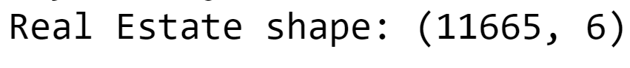
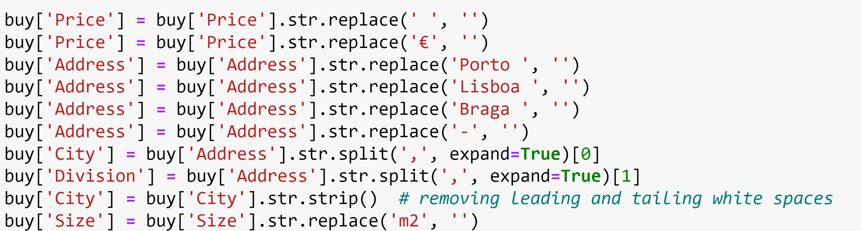
Step 2 Data Handling
What we change
In this step, we cleaning, formatting and filtering the data.
-Splitting columns
-Remove duplicates rows and cols
-Remove unwanted marks
( € , '/' )
-Edit Types of variables

Slide 11
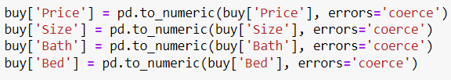
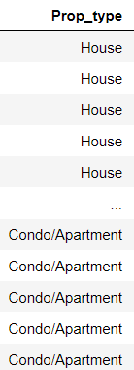
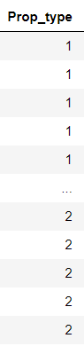
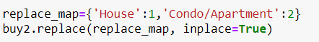
Types Handling
For each column we change the type from category
to numeric , help in the next step and make more easiest to work on the data
Property Type
Using replace map -
we change all the property type
from category to numeric
'1' to Houses and '2' to apartments

Slide 12
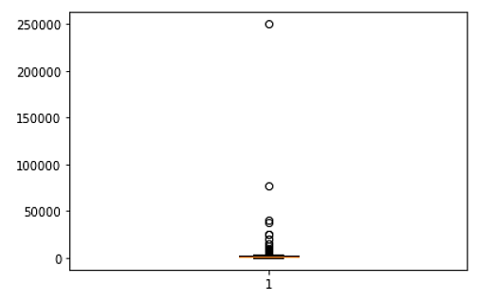
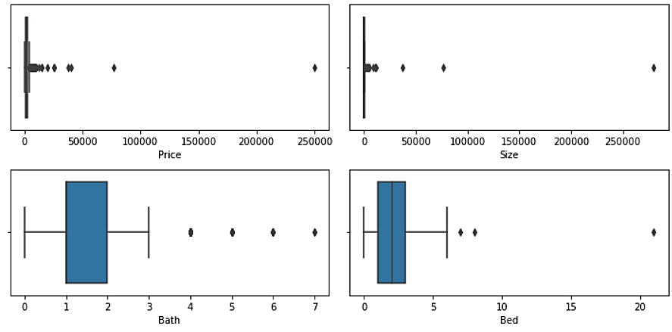
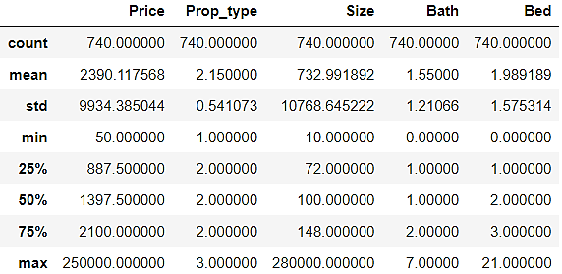
Step 3 Exploring Data
The Process
We did some visualization with our data
after all the cleaning.
With the EDA we did outliers treatment
and remove unnecessary data.
We start from the data frame of the properties for rent

Slide 13
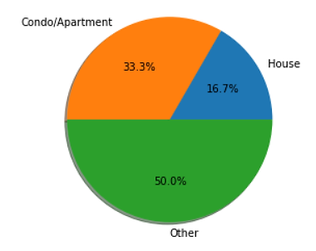
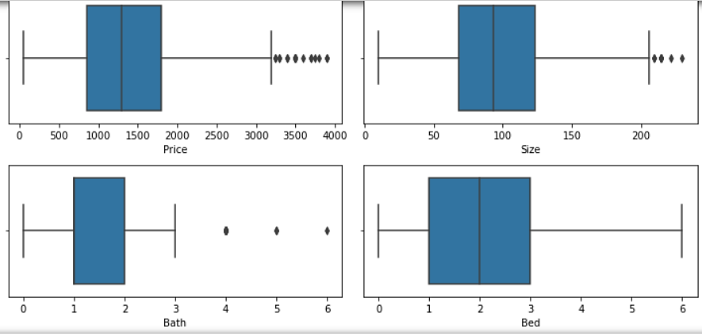
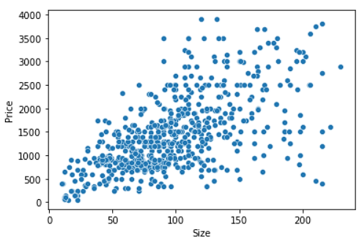
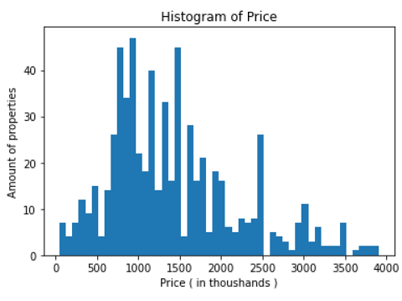
Visualization after the cleaning
We did some visualization with various of plots .

Slide 14
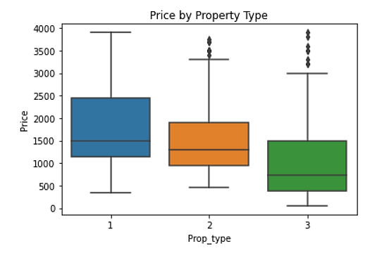
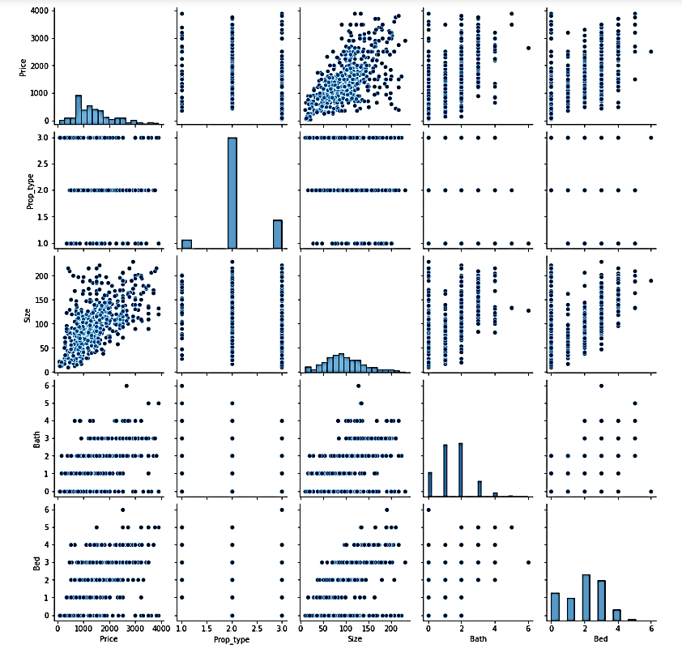
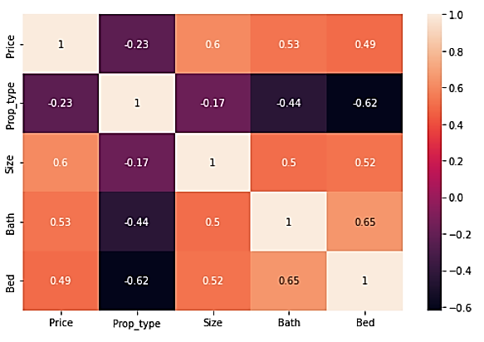

Slide 15
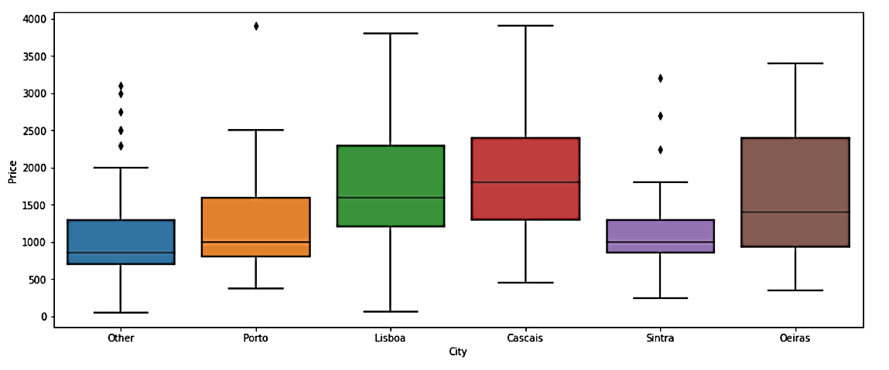
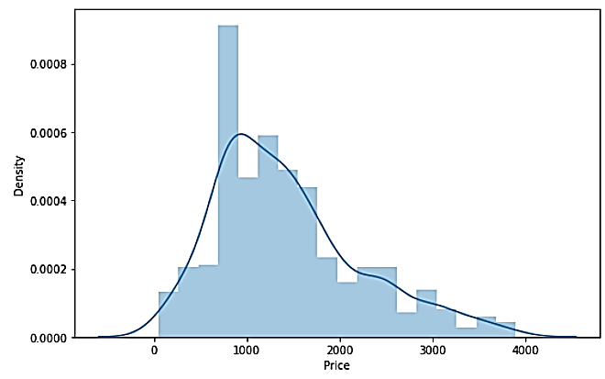

Slide 16
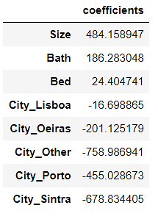
Step 4 Machine Learning
Supervised Learning
Supervised learning is a type of machine learning in which the computer is provided with labeled data and it is expected to generate a predictive model. This model is then used to make predictions about new data.
Supervised learning can be used to classify data, predict outcomes, and identify patterns.

Slide 17
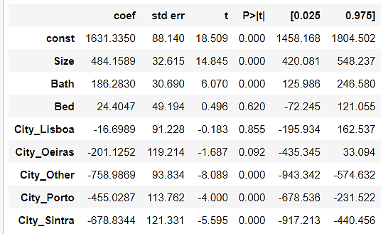
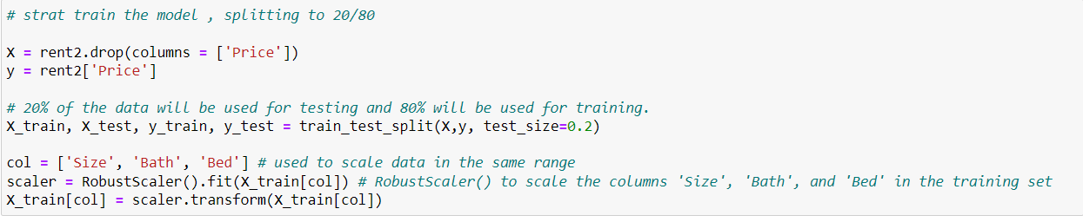
The Process
we start to train and test when we scaled the data
and after we did the same without scaling ( without modeling on the Z-score )
The Process
we use 20% of the data to test
and 80% to train
our X column was the Bed, Size and Bath
and our Y column was the Price

Slide 18
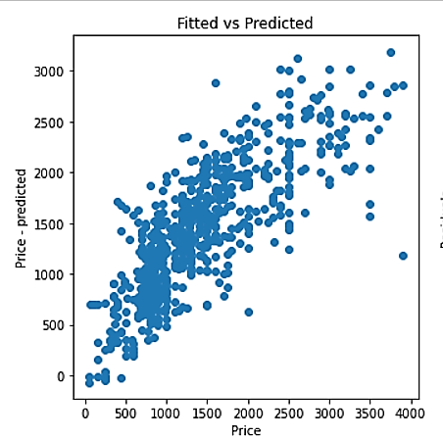
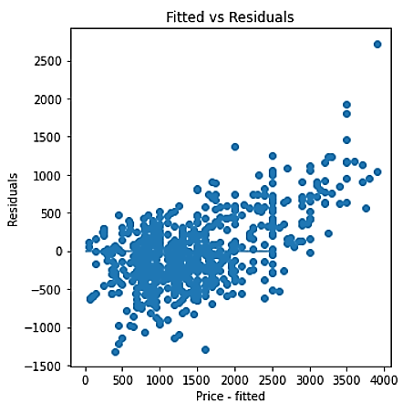
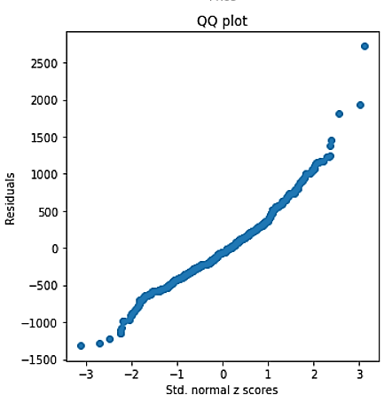
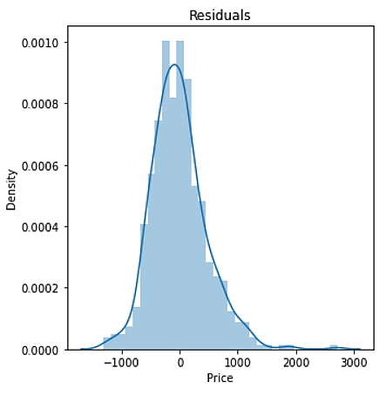
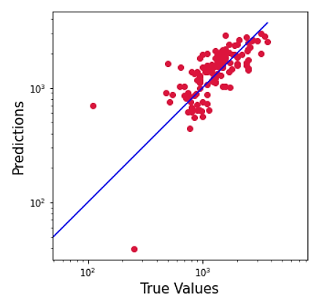
Linear Regression Equation
Some of the result

Slide 19
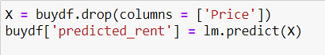
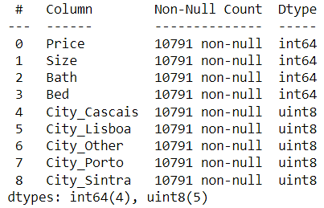
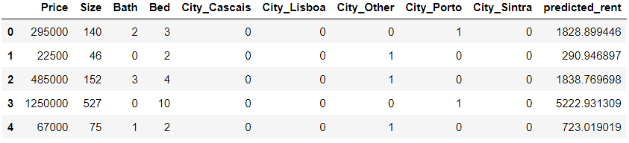
The Process
While we get our linear regression equation
we load the buy data
and fit the data to look like the same data
as the rent .
After we train the Price data
with the linear regression predict we got previously,
and then we get the predicted rent column about the buy data

Slide 20
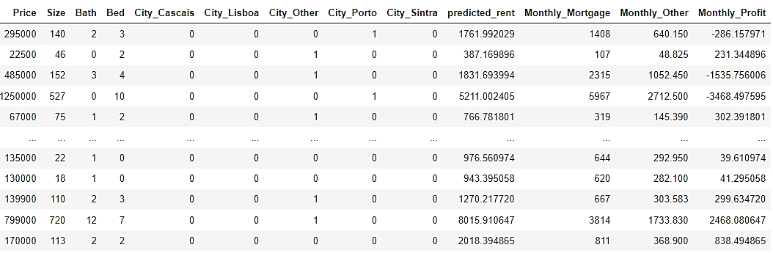
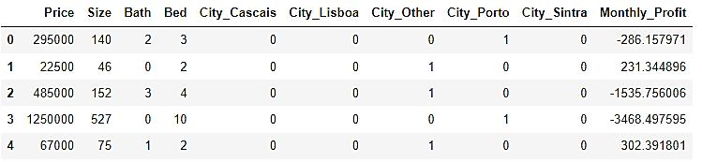
Start to working on the property to buy data
The last step
is to load the buy data after adding the predicted rent column.
we calculate with the Portugal formula to
calculate the monthly mortgage and other
monthly expense , such as insurance or property tax
and make one column that shows , how much
profit the property owner stay with at the end of the month.

Slide 21
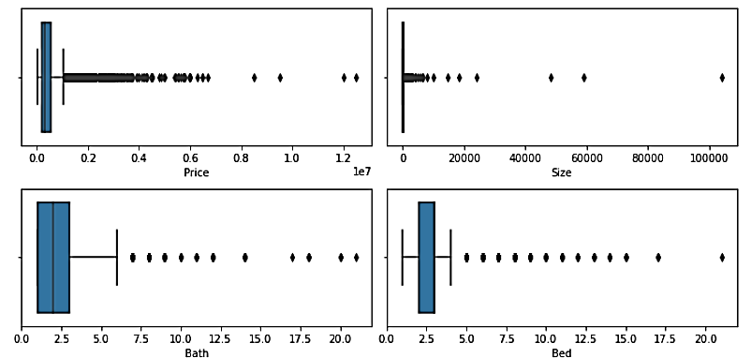
Eda And Data Handling
We did again
Eda and outliers treatment on the new data
to make a cleanier data to work on
with the machine learning modules.

Slide 22
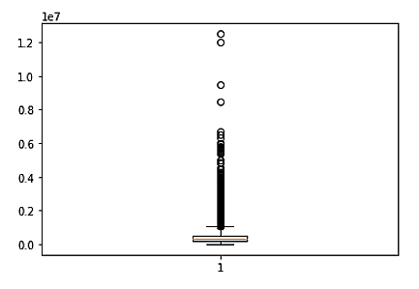
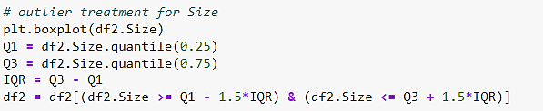
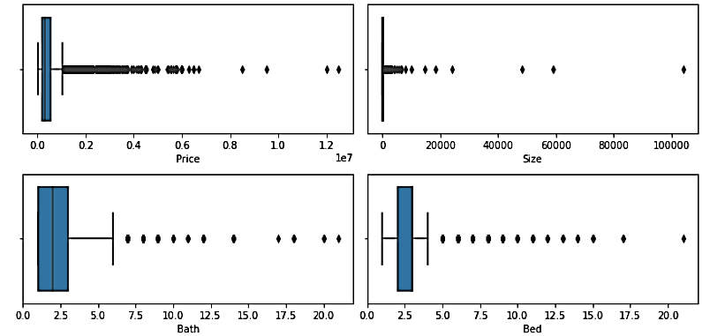
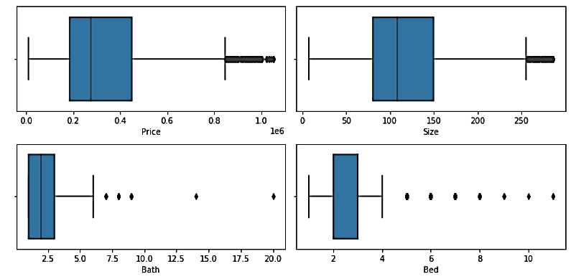
Eda And Data Handling

Slide 23
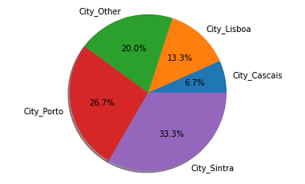
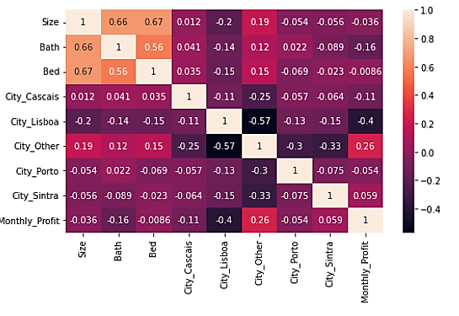
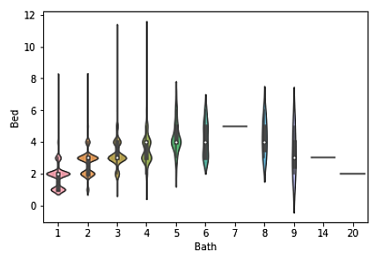
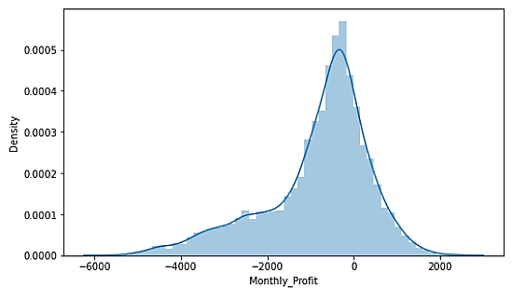
EDA
Some of the visualization we get after
cleaning the data

Slide 24
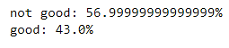
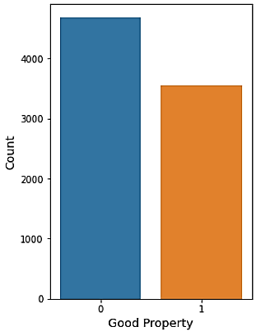
Good Property
We decide that good property
is a property that his owner
doesn't lost more than 400 euro per month
Good Property
‘0’ = Not good property
‘1’ = Good Property

Slide 25
Step 5 Interpreting Data
Buy Machine Learning
in the last step
Everything we've learned so far from the machine learning we've done on rental properties
We operated on properties to buy, and finally presented the data, results and conclusions

Slide 26
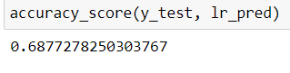
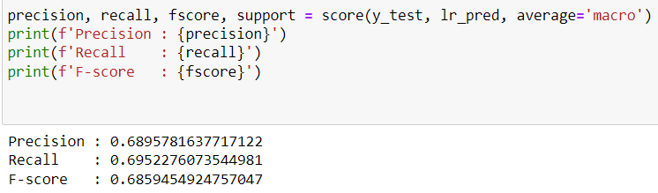
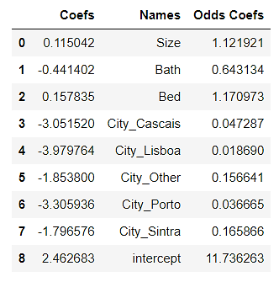
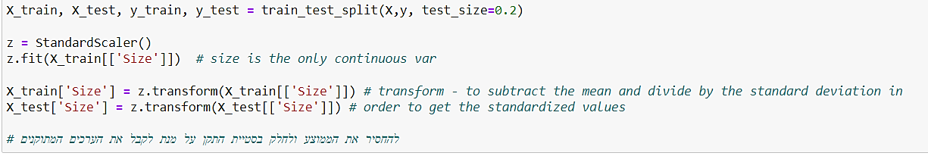
Supervised Learning
Supervised Learning :
Again , we did a machine learning, But now on the buy data frame , and the target column to predict and learning the machine on is the 'good prop' column.

Slide 27


Result
The accuracy results Visualizations for illustration
Linear Regression Accuracy
Decision Tree

Slide 28



Model Comparison

Slide 29

Roc Curve Result

Slide 30
Conclusion
As we can see
the best score we get is from the
SVM model.
As you can see
the best score we get is from the
SVM model.
Our conclusion is that it is indeed possible to identify a good investment property in Portugal.
We have indeed seen that machine learning models achieve quite good results.
It was also said that to improve the accuracy more information is needed which cannot be obtained
Apartment sale and rental site
such as the construction price, the quality of the neighborhood, average electricity and water prices for the property
The specific one being tested, and more

Slide 31




overfitting and bias
Our Failures
Scrapping Problems

Slide 32








Resource and useful Pages

Slide 33
Thanks for listening!
Roy And Yarin

